Slide 1



Portfolio Assessment
STEPHANIE PRUNA

Slide 2
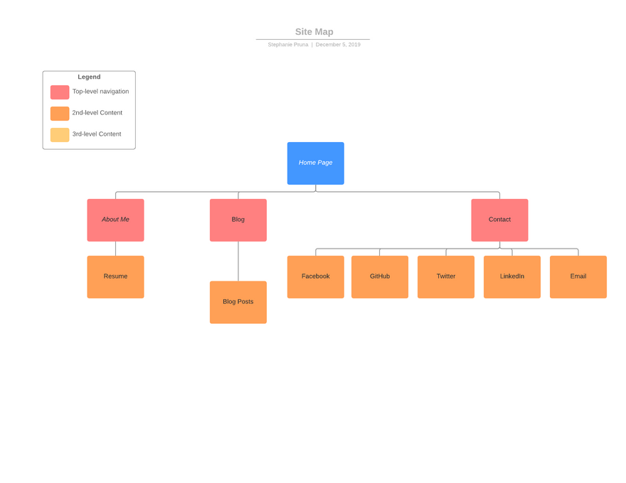
SITEMAP

Slide 3
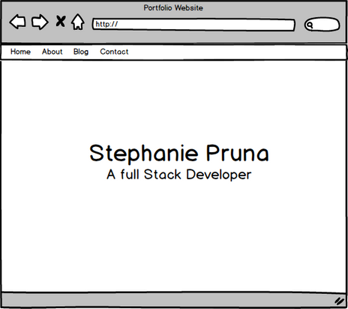
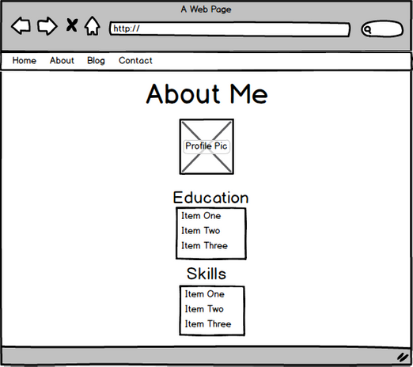
WIREFRAMES

Slide 4
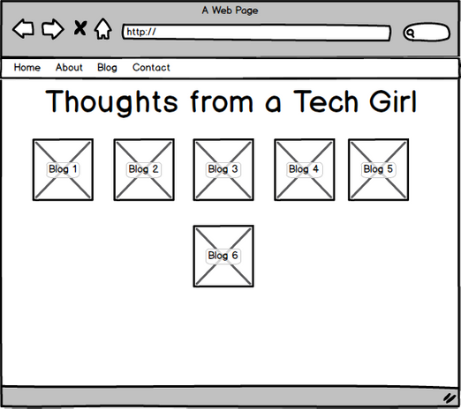
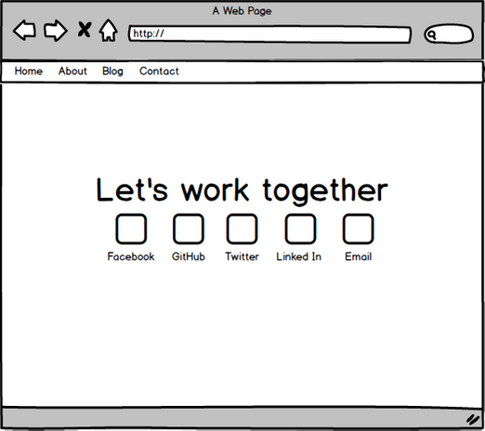
WIREFRAMES

Slide 5
Design Process
LIST
RESEARCH
MOCK UP
PICTURES
Created a list of requirements sorted into page names
Researched some portfolios online to get some ideas
Drew some ideas on paper and created a wireframe
Sourced free photos and created icons and blog posts using canva

Slide 6
Development/Build Process
FAVORITE PARTS
BLOG PAGE
DATA
BUILD PROCESS
How much of my data did i want on the internet? Was ok with resume but not ok with phone number
Contact page and Blog Page. It was fun working with the layout and icon/picture size.
Grid/Flexbox would not place pictures correctly. This was a HTML issue not CSS
HTML first then CSS. CSS and responsive web design more challenging than i thought.

